Slide 1
Chapter 7
FEATURE
EXTRACTION AND SELECTION
METHODS
Part 1
Cios / Pedrycz / Swiniarski / Kurgan

Slide 2
Outline
Feature Extraction
  PCA
  Supervised PCA based on Fisher’s Discriminant Analysis
  Sequence of PCA and Fisher’s
  Singular Value Decomposition
  Independent Component Analysis
  Vector Quantization and Compression
  Learning Vector Quantization
  Fourier Transform
  2D Fourier Transform
  Wavelets
  Zernicke Moments
© 2007 Cios / Pedrycz / Swiniarski / Kurgan

Slide 3
Outline
Feature Selection
- Paradigms
- Methods
Open Loop / Filter based on: Minimum Description Length, Mutual Information, Inconsistency Count, Rough Sets’ Quality Classification, Interclass Separatibility
Closed Loop / Wrapper based on classifier performance
- Computing Feature Selection Criteria
- Search Methods
- Branch and Bound
- Individual Feature Ranking
- Forward and Backward Feature Selection
- Feature Scaling
© 2007 Cios / Pedrycz / Swiniarski / Kurgan

Slide 4
Introduction
Some typical data preprocessing tasks:
Normalization
Elimination of outliers
Coping with missing values
Reduction of dimensionality via feature extraction and selection
© 2007 Cios / Pedrycz / Swiniarski / Kurgan

Slide 5
Reasons for Feature Extraction/Selection
Engineering restrictions
- design of a classifier / its hardware implementation
- communication channel capacity
Classification performance
- often data sets are relatively small but of high dimensionality
PEAKING PHENOMENON – performance improves as new features are added / removed
but then it degrades
© 2007 Cios / Pedrycz / Swiniarski / Kurgan

Slide 6
Introduction
The goal of data preprocessing is to clean, enhance
and transform the data into
the best FOR SOME FURTHER PROCESSING GOAL form
Preprocessing of data is performed to:
remove redundancy
compress data
reduce dimensionality
build a model of data for future predictions
© 2007 Cios / Pedrycz / Swiniarski / Kurgan

Slide 7
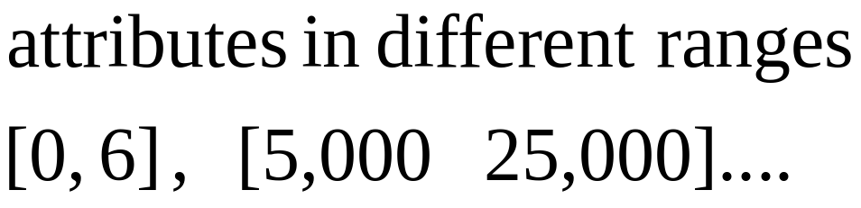
Normalization
Reason
© 2007 Cios / Pedrycz / Swiniarski / Kurgan

Slide 8
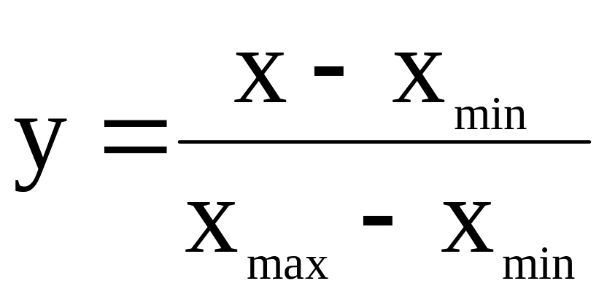
Normalization(1)
© 2007 Cios / Pedrycz / Swiniarski / Kurgan

Slide 9
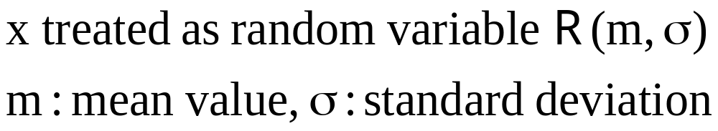
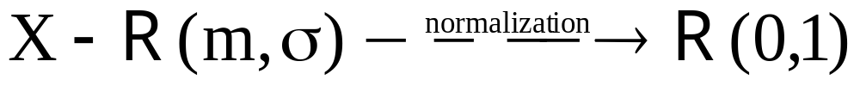
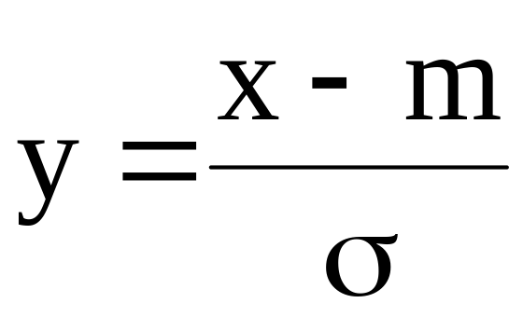
Normalization(2)
© 2007 Cios / Pedrycz / Swiniarski / Kurgan

Slide 10
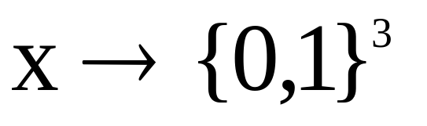

Normalization(3)
© 2007 Cios / Pedrycz / Swiniarski / Kurgan

Slide 11
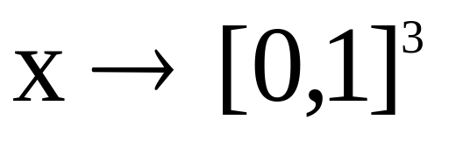

Normalization(4)
© 2007 Cios / Pedrycz / Swiniarski / Kurgan

Slide 12
Outliers
Some reasons for outliers:
measurements are affected by noise
data improperly recorded
device malfunctions
© 2007 Cios / Pedrycz / Swiniarski / Kurgan

Slide 13

Missing values(1)
© 2007 Cios / Pedrycz / Swiniarski / Kurgan

Slide 14

Missing values(2)
© 2007 Cios / Pedrycz / Swiniarski / Kurgan

Slide 15

Missing values(3)
© 2007 Cios / Pedrycz / Swiniarski / Kurgan

Slide 16
Missing values(4)
Use the record:
just ignore the missing
value(s)
© 2007 Cios / Pedrycz / Swiniarski / Kurgan

Slide 17
Introduction
Preprocessing via Feature Extraction (FE) and Feature Selection (FS)
Definition:
FE / FS is a sequence of operations (transformations) converting raw data into lower-dimensional data suitable for SPECIFIC SUBSEQUENT processing tasks
© 2007 Cios / Pedrycz / Swiniarski / Kurgan

Slide 18
Introduction
Feature Extraction – process of finding a number of descriptors/features from raw data that contain the best information about objects in terms of a specific processing goal;
often a transformation into a NEW FEATURE SPACE
Feature Selection – process of finding the best subset of features, from original features, according to a processing goal or a feature selection criterion
© 2007 Cios / Pedrycz / Swiniarski / Kurgan

Slide 19

Introduction
Key methods of dimensionality reduction
feature extraction
© 2007 Cios / Pedrycz / Swiniarski / Kurgan

Slide 20
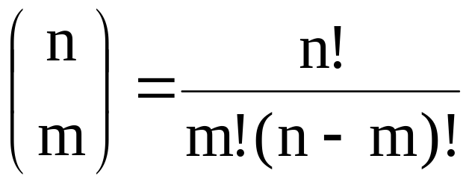
Introduction
x2
Feature selection
x2
x1
x1
© 2007 Cios / Pedrycz / Swiniarski / Kurgan

Slide 21
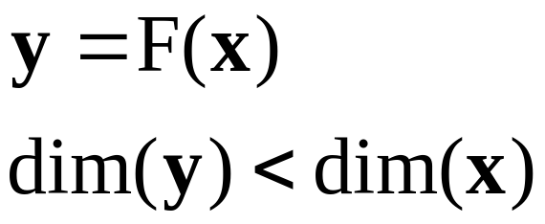
Introduction
Feature extraction
y 1
© 2007 Cios / Pedrycz / Swiniarski / Kurgan

Slide 22
Feature Extraction
Feature extraction is performed in two key ways:
Unsupervised
- Principal Component Analysis
- Singular Value Decomposition
- Independent Component Analysis
- Vector quantization
- Fourier transform
- Wavelets
- Zernicke moments
Supervised
- Fisher’s linear discriminants
© 2007 Cios / Pedrycz / Swiniarski / Kurgan

Slide 23
Feature Extraction
Goal: to lower dimensionality of a pattern by extracting the most informative features
Term “most informative feature” depends on the goal of preprocessing
Example:
For a recognition purpose we want to extract compact, most important, and maximally uncorrelated features that retain maximal information about the original data, but with better generalization abilities
© 2007 Cios / Pedrycz / Swiniarski / Kurgan

Slide 24
PCA
PCA is a method for reducing dimensionality by linear combination of features.
Linear combinations are used because of their simplicity and tractability. There are two approaches:
  PCA finds projections that best represent the data in the least-square (LS) sense
© 2007 Cios / Pedrycz / Swiniarski / Kurgan

Slide 25
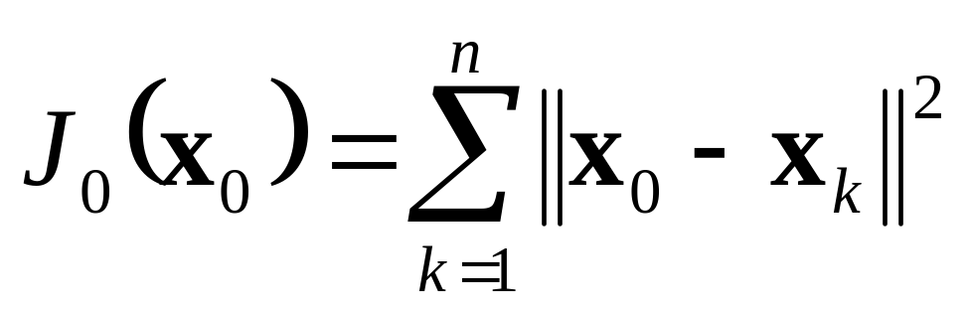
PCA
Key idea of PCA (after Duda et al.)
Let us represent d-Dimensional vectors x₁,…x_{k},…x_{n}
by a single vector x₀ - in the LS sense
Let us define the functional:
© 2007 Cios / Pedrycz / Swiniarski / Kurgan

Slide 26
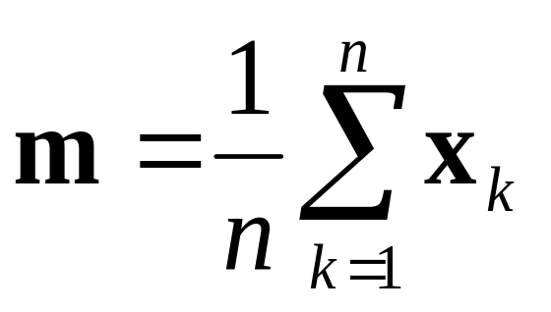
PCA
The solution is given by
x₀ =
Zero-D representation of data
© 2007 Cios / Pedrycz / Swiniarski / Kurgan

Slide 27
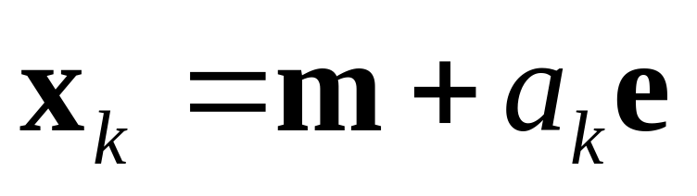
PCA
Now let us find a 1-D representation of the data by projecting it onto a line running through m
The line equation:
a_{k} – distance of vector x_{k} from m
e – unit directional vector
© 2007 Cios / Pedrycz / Swiniarski / Kurgan

Slide 28
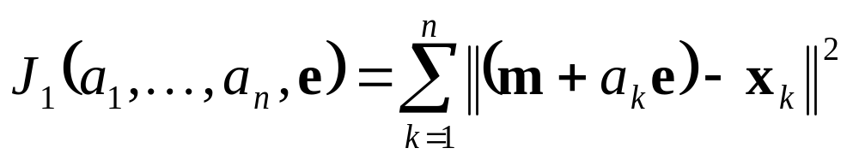
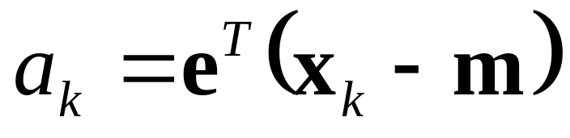
PCA
To find a_{k} let’s define functional:
LS solution means projecting it onto a line
x_{k}
m
e
© 2007 Cios / Pedrycz / Swiniarski / Kurgan

Slide 29
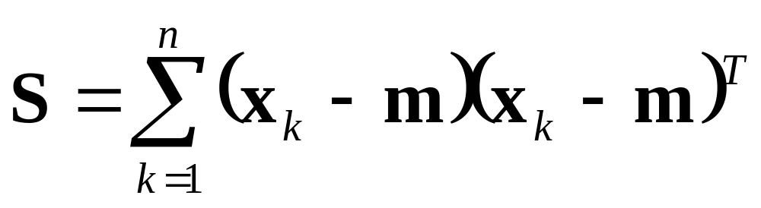
PCA
How to find the best direction of the line?
To do so we define a scatter matrix:
© 2007 Cios / Pedrycz / Swiniarski / Kurgan

Slide 30
PCA
The solution is to project the data onto a
line going through “m” in the direction of the eigenvector of S, which corresponds to the largest eigenvalue
© 2007 Cios / Pedrycz / Swiniarski / Kurgan

Slide 31
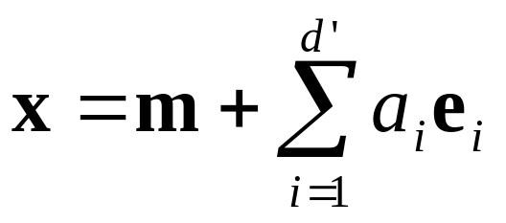
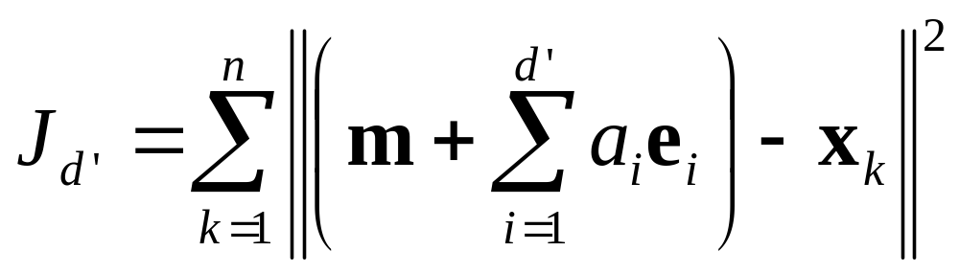
PCA
To extend from 1-D to d’-D projection
a_{i} – principal components
The functional has minimum when vectors e₁,…e_{d’}
are d’ eigenvectors of S - corresponding to the largest eigenvalues ordered in decreasing order
© 2007 Cios / Pedrycz / Swiniarski / Kurgan

Slide 32
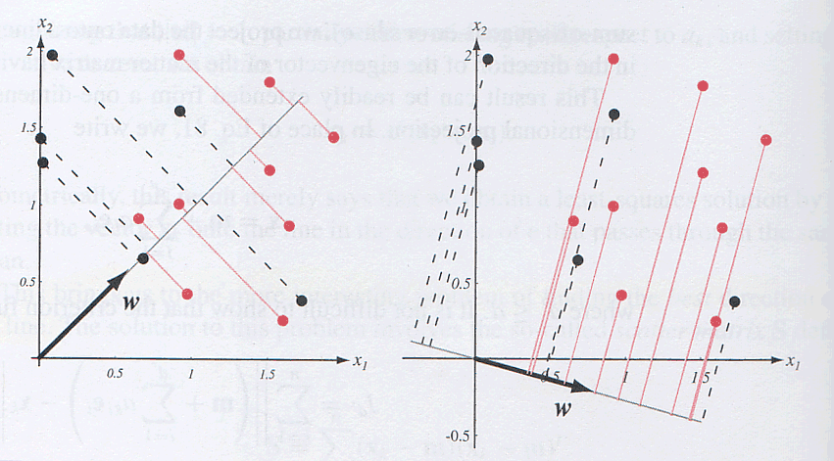
from Duda et al. book

Slide 33
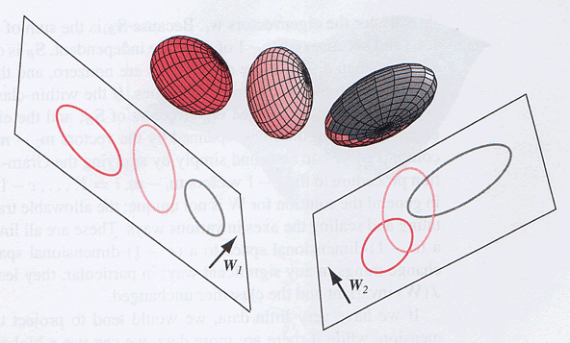
PREPROCESSING
from Duda et al. book

Slide 34
PCA
In FE we are interested in mapping the n-dimensional original pattern “x” into a transformed m-dimensional pattern “y” called feature vector, via transformation:
y = F(x)
where m<=n
In general, F is a non-linear function, but we are interested only in linear transformations of the type:
y = Wx
where the transformation matrix W is optimal in the sense of retaining
maximum of the original information
© 2007 Cios / Pedrycz / Swiniarski / Kurgan

Slide 35
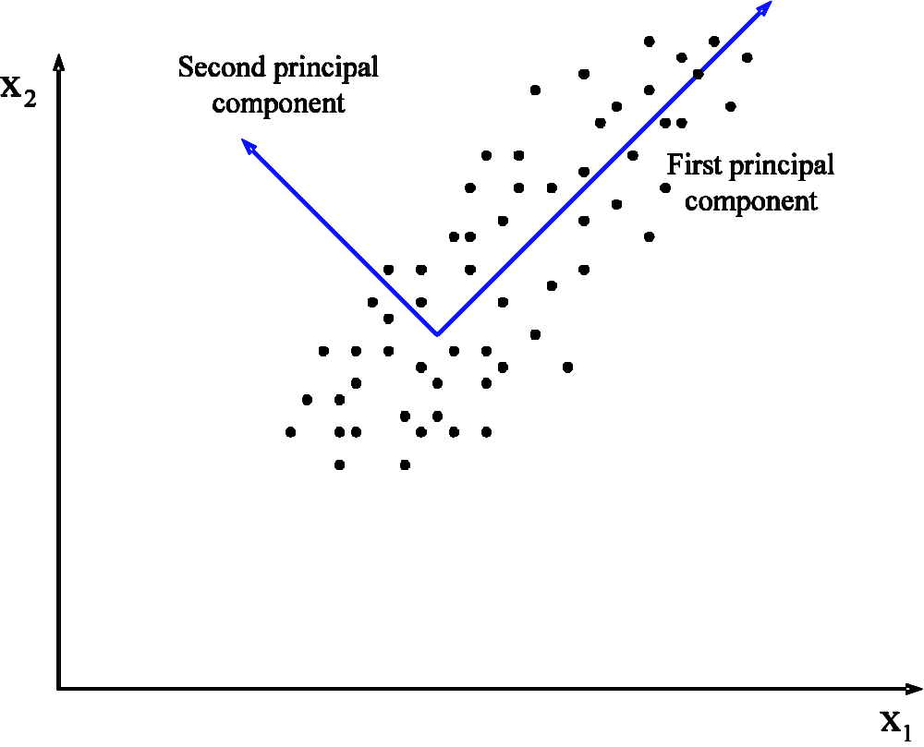
PCA
Principal components
© 2007 Cios / Pedrycz / Swiniarski / Kurgan

Slide 36

Variance modified from: Elias Raftopoulos HY539 29/3/06
Variance is a measure of the spread of the data
  Var( X ) = E(( x – μ )^2)
Why have both variance and StDev to measure the spread of data?
Variance is the original statistical measure of spread.
However, since it’s unit is expressed as a square (e.g., cm^2) so StDev (the square root of variance) is often used instead.

Slide 37

Covariance
Variance is a measure of the deviation from the mean for points in one dimension (e.g., heights)
Covariance is a measure of how much each of the many dimensions vary from the mean with respect to each other.

Slide 38
Covariance Matrix
Covariance as a matrix:
cov(x,x) cov(x,y) cov(x,z)
C = cov(y,x) cov(y,y) cov(y,z)
cov(z,x) cov(z,y) cov(z,z)
On diagonal we have the variances of x, y and z
cov(x,y) = cov(y,x) hence it is symmetrical about the diagonal
N-dimensional data always result in nxn covariance matrix

Slide 39
Covariance
A positive value of covariance indicates that both dimensions increase or decrease together
A negative value indicates that while one increases the other decreases.
If covariance is zero then two dimensions are independent of each other.

Slide 40
Eigenvalue problem
The eigenvalue problem is any problem in this form:
A . v = λ . v
  A: nxn matrix
  v: nx1 non-zero vector
  λ: scalar
Any value of λ for which this equation has a solution is called the eigenvalue of A,
and the vector v which corresponds to it is called the eigenvector of A.

Slide 41
Eigenvalue problem
2 3 3 12 3
2 1 2 8 2
A . v = λ . v
(3,2) is an eigenvector of A and 4 is an eigenvalue of A
x
=
=
4
x

Slide 42
Calculating eigenvectors & eigenvalues
Given A . v = λ . v
A . v - λ . I . v = 0
(A - λ . I ). v = 0
Finding the roots of |A - λ . I| will give the eigenvalues and to each eigenvalue there is a corresponding eigenvector

Slide 43
Calculating eigenvectors & eigenvalues
If A = 0 1
-2 -3
Then |A - λ . I| = 0 1 λ 0 = 0
-2 -3 0 λ
-λ 1 = λ2 + 3λ + 2 = 0 = (-λ)(-3-λ)-(1x(-2))
-2 -3-λ
Solving for λ gives 2 eigenvalues: λ1 = -1 and λ2 = -2
det

Slide 44
PCA
Linear transformation
y = W x
x – n-dimensional original pattern
y – m-dimensional transformed pattern
W – (m x n) optimal transformation matrix
Matrix W ensures compact data representation that retains maximum, non-redundant and uncorrelated, information from the original data.
W is created by calculating a covariance matrix and its eigenvalues/eigenvectors
© 2007 Cios / Pedrycz / Swiniarski / Kurgan

Slide 45
PCA
Properties:
Features of vector y are statistically independent (uncorrelated)
Reduction of dimensionality is achieved by discarding features with the lowest information content
(i.e., the eigenvectors corresponding to the smallest eigenvalues)
3. Amount of dimensionality reduction depends on the amount of correlation and redundancy in the original data
4. PCA is an unsupervised method (does not use class information) that discovers correlations among patterns, and where the patterns correlation changes the most
5. Transformation is orthogonal
© 2007 Cios / Pedrycz / Swiniarski / Kurgan

Slide 46
PCA
Equations:
Data set T_{tra}={x¹,x²,…,x^{N}}
Data pattern matrix (N x n) X=(T_{tra})^{T}
n-dimensional mean vector µ=E[x]=[E[x₁],E[x₂],…,E[x_{n}]]^{T}
Covariance matrix (n x n) R_{x}=E[(x-µ)(x-µ)^{T}]
Eigenvalue problem R_{x}e^{i}=λ_{i}e^{i}, i=1,2,…,n
Orthonormal eigenvectors matrix E=[e¹,e²,…,e^{n}]
Transformation matrix (n x n) W=E^{T}
N – number of patterns, n – dimension of each pattern
© 2007 Cios / Pedrycz / Swiniarski / Kurgan

Slide 47
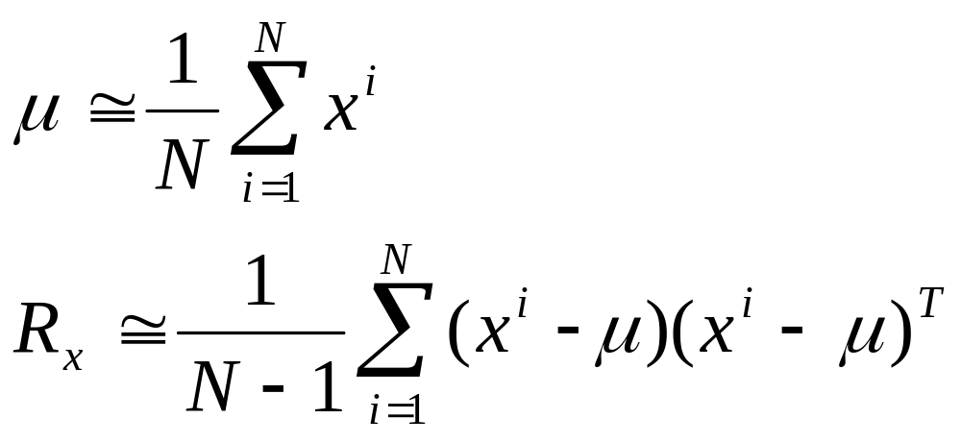
PCA
Equations for finite number of patterns N:
n-dimensional mean vector µ
Covariance matrix is always (n x n)
© 2007 Cios / Pedrycz / Swiniarski / Kurgan

Slide 48
PCA
Calculating transformation matrix W:
Calculate covariance matrix
Calculate its eigenvalues
Calculate eigenvectors corresponding to eigenvalues
Create matrix W from normalized eigenvectors, starting with one corresponding to the largest eigenvalue, then the second largest, etc.
Usually we use only the dominant eigenvectors that correspond to the first m largest eigenvalues
© 2007 Cios / Pedrycz / Swiniarski / Kurgan

Slide 49
PCA
Reconstruction of pattern x
Estimated value of the reconstructed pattern x is:
x^ = W⁻¹ y = W^{T} y = W^{T} W x
W⁻¹=W^{T} because W is orthonormal
Reconstruction error criterion: the mean LS error between x and x^ - PCA minimizes this error
© 2007 Cios / Pedrycz / Swiniarski / Kurgan

Slide 50
PCA
Theorem
Given the data and its covariance matrix:
a) Find and arrange eigenvalues in decreasing order
b) Assume that the corresponding orthonormal eigenvectors compose orthonormal matrix E
Then the optimal linear transformation
y^ = W^ x = E^{T} x
transforms n-D original pattern x into m-D feature pattern y that minimizes reconstruction error.
The optimal transformation matrix W^ is called Karhunen-Loeve
or Hotelling transformation.
© 2007 Cios / Pedrycz / Swiniarski / Kurgan

Slide 51
PCA
Reconstruction error is estimated by the sum of eigenvalues whose corresponding eigenvectors were discarded from matrix W^
Dimensionality Reduction:
Choose the first m eigenvalues to create matrix W^
How to choose the value of m:
Choose the first m eigenvalues for which the reconstruction error is less than the user-chosen threshold
© 2007 Cios / Pedrycz / Swiniarski / Kurgan

Slide 52
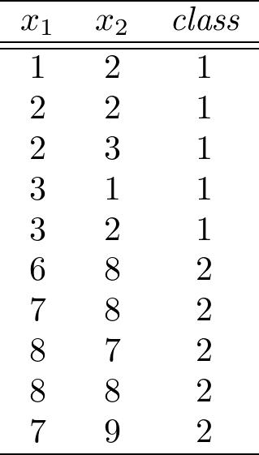
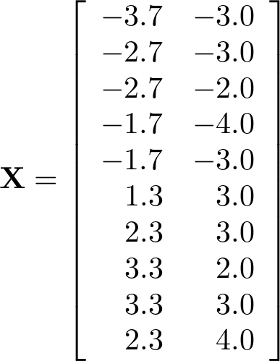
PCA
Example:
Two-class data set
The zero mean data pattern matrix
© 2007 Cios / Pedrycz / Swiniarski / Kurgan

Slide 53
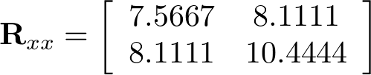
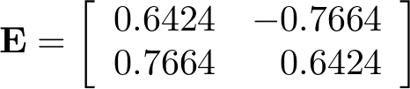
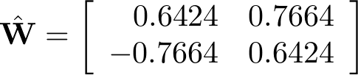
PCA
Covariance matrix
Eigenvector matrix
Eigenvalues
Optimal KLT transformation matrix
© 2007 Cios / Pedrycz / Swiniarski / Kurgan

Slide 54

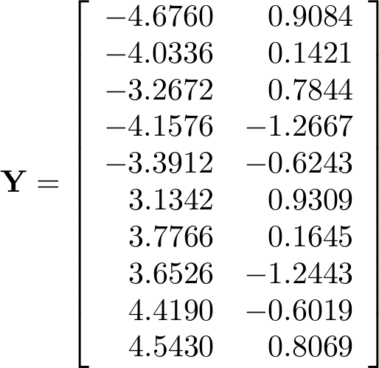
PCA
Projection of all vectors onto principal component space by
© 2007 Cios / Pedrycz / Swiniarski / Kurgan

Slide 55

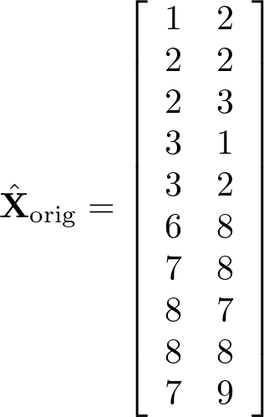


PCA
Reconstruction of (all) original pattern vectors is done by
© 2007 Cios / Pedrycz / Swiniarski / Kurgan

Slide 56

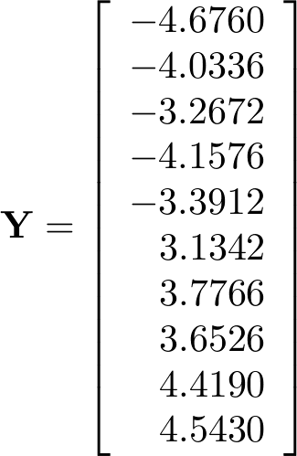
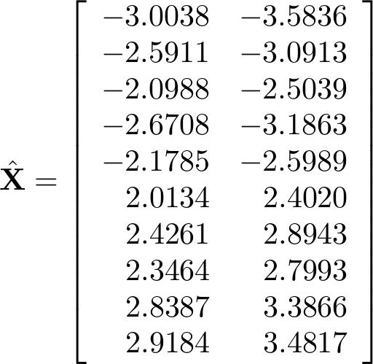
PCA
Optimal KLT transformation matrix
Projection of all vectors
onto the principal component space
Reconstruction of all
original pattern space vectors
© 2007 Cios / Pedrycz / Swiniarski / Kurgan

Slide 57
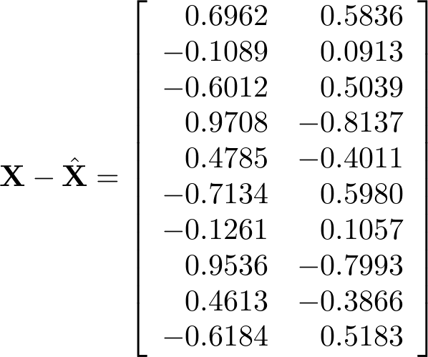

PCA
Reconstructed error vectors
The calculated LS error
is equal to the sum of the discarded eigenvalues =
© 2007 Cios / Pedrycz / Swiniarski / Kurgan

Slide 58
PCA
Iris data
Number of Instances: 150 (50 in each of the 3 classes)
Number of Attributes: 4 (numeric) plus class information
Attributes and Classes:
1. sepal length (all in cm) 2. sepal width
3. petal length 4. petal width
5. class: Iris Setosa, Iris Versicolour, Iris Virginica
Missing attribute values: None
© 2007 Cios / Pedrycz / Swiniarski / Kurgan

Slide 59
PCA
Iris data
T_{tra} matrix (n x N)
n=4, N=150
Matrix W
0.3616 -0.0823 0.8566 0.3588
0.6565 0.7297 -0.1758 -0.0747
-0.5810 0.5964 0.0725 0.5491
-0.3173 0.3241 0.4797 -0.7511
Eigenvalues
4.2248 0.2422 0.0785 0.0237
© 2007 Cios / Pedrycz / Swiniarski / Kurgan

Slide 60
PCA
Monks 1 data
Number of Instances: 124
Number of Attributes: 8 (including class attribute)
Attribute information:
1. class: 0, 1
2. a1: 1, 2, 3
3. a2: 1, 2, 3 4. a3: 1, 2
5. a4: 1, 2, 3 6. a5: 1, 2, 3, 4
7. a6: 1, 2
8. Id: A unique symbol for each instance
Missing attribute values: None
© 2007 Cios / Pedrycz / Swiniarski / Kurgan

Slide 61
PCA
Monks 1 data
T_{tra} matrix (n x N)
n=6, N=124
Matrix W
-0.2411 0.2185 0.8917 -0.2806 0.0944 -0.1068
0.0657 -0.6109 0.3859 0.6879 0.0029 0.0191
0.0209 0.0248 0.0361 0.0175 -0.8626 -0.5032
0.1176 -0.7370 -0.0086 -0.6584 0.0233 -0.0949
0.9601 0.1871 0.1924 -0.0325 0.0596 -0.0404
0.0394 -0.0175 0.1327 -0.1153 -0.4928 0.8511
Eigenvalues
1.3240 0.7918 0.6278 0.5546 0.2569 0.2299
© 2007 Cios / Pedrycz / Swiniarski / Kurgan

Slide 62
PCA
Monks 1 data
Evaluation of PCA using CLIP algorithm
Number of features | Eigenvalues discarded | Number of rules |  | Sensitivity Train/Test | Specificity Train/Test | Accuracy Train/Test
Original 6 | N/A | 3 |  | 100 / 100 | 100 / 100 | 100 / 100
Transformed 6 | None | 10 |  | 100 / 60.65 | 96.77 / 75.00 | 98.39 / 67.82
Transformed 5 | 0.2299 | 9 |  | 100 / 59.26 | 95.16 / 76.85 | 97.58 / 68.06
Transformed 4 | 0.2569 | 9 |  | 100 / 59.26 | 91.94 / 74.07 | 95.97 / 66.67
Transformed 3 | 0.5546 | 4 |  | 100 / 70.37 | 56.45 / 64.81 | 78.23 / 67.59
Transformed 2 | 0.6278 | 2 |  | 100 / 88.89 | 33.87 / 55.56 | 66.94 / 72.22
Transformed 1 | 0.7918 | 1 |  | 100 / 100 | 27.42 / 50.00 | 63.71 / 75.00
© 2007 Cios / Pedrycz / Swiniarski / Kurgan

